Slide 1

Windows 10 in S Mode at Marshall Public Schools

Slide 2
District Demographics
Approximate numbers
2549 Students K-12
Located in Southwest Minnesota

Slide 3
MPS Technology Team
Superintendent - Scott Monson
Director of Teaching and Learning – Jeremy Williams
District Network Services Coordinator – Todd Pickthorn
Technology Integration Specialist – Karen Londgren
District Computer Technician – Nicholas Esping
District Computer Technician – Kent Powell
Media Specialist Middle and High School – Erica Hess
Media Specialist Park Side and West Side Elementary – Kaia Johnson- Maggie Jans
Media Staff in our buildings are first line of support!
Success = 80% People, 20% technology

Slide 4
Windows 10 in S Mode
https://www.youtube.com/watch?v=Lqm_lRCL-G0
We were nominated for this pilot.
Marshall Public Schools was already invested in much of the Windows Education stack (Office 365, Intune, Windows Store for Education) and would benefit from working with Microsoft Experts to help configure a Windows 10 in S mode pilot which helps to maximize their existing investments.
Advantages of Windows 10 in S Mode:
Lower cost devices, Simple Deployments, Windows Store for Education, Simple Management using Intune for Education, Enhanced Security, Improved Performance, and simple reset capabilities.
10S overview
https://docs.microsoft.com/en-us/windows-hardware/manufacture/desktop/windows-10-s-overview

Slide 5
Windows 10 in S mode
Windows 10 in S mode really is a new mode of Windows 10 that Microsoft that is designed to run on lighter devices so you can provide better security and much easier management. That ‘S’ doesn’t use a specific designation, but Microsoft generally surrounds it with words like security, streamlined, superior performance ?- you get the idea. Windows 10 in S mode isn’t another type of Windows 10 – truth be told, it can be enabled for wither Windows 10 Home or Pro – rather it’s a special mode that essentially limits Windows 10 inside ways to helps it be run faster, provide longer battery, and be secure and easier to manipulate. The idea is that PC manufacturers can ship devices in S mode making them as good as Chromebooks in educational environments. They are for any organization that necessitates higher security and easier maintenance.
Windows 10 in S mode only allows apps to be installed through the Windows Store
Microsoft Edge is the default browser in S mode

Slide 6
Windows Autopilot Info
Before deploying a device using Windows Autopilot, the device must be registered with the Windows Autopilot deployment service. Ideally, this would be performed by the OEM, reseller, or distributor from which the devices were purchased, but this can also be done by the organization through collecting the hardware identity and uploading it manually.
The hardware ID, also commonly referred to as a hardware hash, contains several details about the device, including its manufacturer, model, device serial number, hard drive serial number, and many other attributes that can be used to uniquely identify that device.
Demo of this.
Harvest and upload your Device ID,
Hardware Hash, Serial Number.
https://www.powershellgallery.com/packages/Get-WindowsAutoPilotInfo/1.3

Slide 7
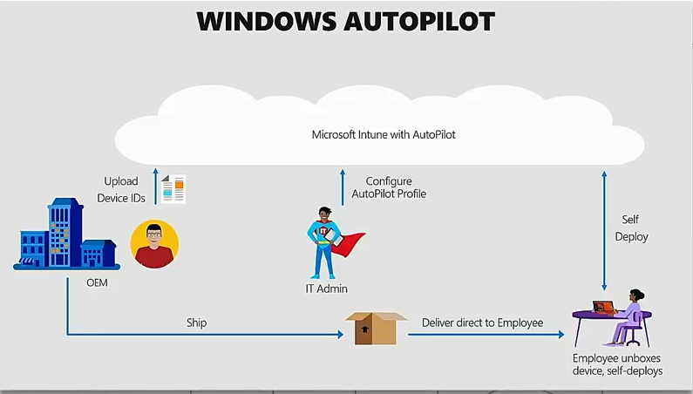

Slide 8
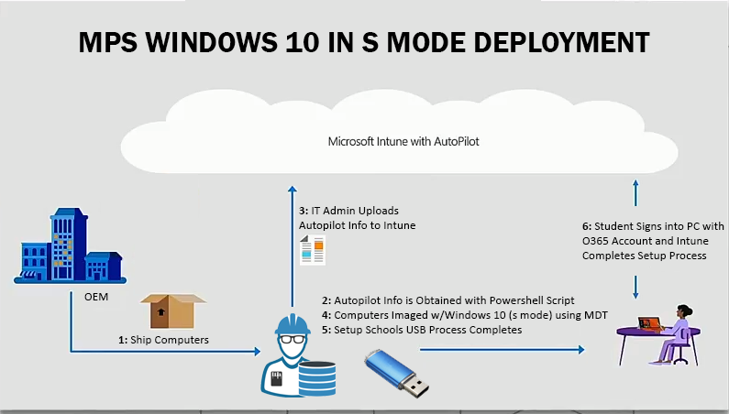

Slide 9
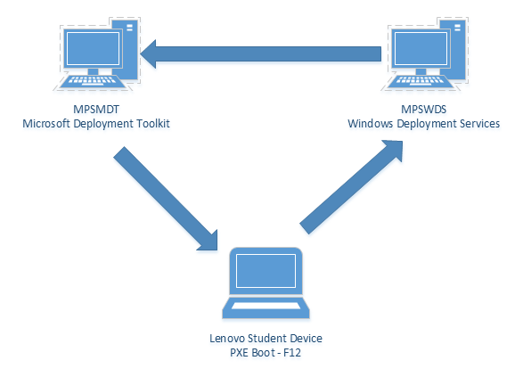
Microsoft 10 in S mode deployment
Using WDS/MDT
https://docs.microsoft.com/en-us/windows-hardware/manufacture/desktop/windows-10-s-deployment-sxs
Marshall Public Schools setup a Windows Deployment Services server to PXE boot machines on the network and then initiate a lite touch Microsoft Deployment Toolkit task sequence that installed the operating system and necessary applications such as Microsoft Office 365 Pro Plus
These are included Free Tools with
a Windows Server license!

Slide 10
Setup School PCs Demo
https://docs.microsoft.com/en-us/education/windows/use-set-up-school-pcs-app
Latest Set up School PCs app
Demo of this.
Reset devices with Autopilot Reset
https://docs.microsoft.com/en-us/education/windows/autopilot-reset
Add office to the image
https://docs.microsoft.com/en-us/windows-hardware/manufacture/desktop/oem-deployment-of-windows-10-for-desktop-editions#preinstall-microsoft-office

Slide 11
Office 365 admin Portal
Demo of logging into Office 365 admin portal and installing applications
Reports
Usage statistics
https://www.youtube.com/watch?v=D1dGkC6mBe8&feature=youtu.be
https://www.microsoft.com/en-us/education/products/windows-10-s/default.aspx
https://educationstore.microsoft.com
https://docs.microsoft.com/en-us/education/windows/test-windows10s-for-edu
https://docs.microsoft.com/en-us/education/windows/configure-windows-for-education
https://docs.microsoft.com/en-us/education/#pivot=itpro&panel=itpro-all
http://customers.microsoft.com/en-us/story/marshall-education-windows-10
https://www.microsoft.com/en-us/education/devices/default.aspx

Slide 12
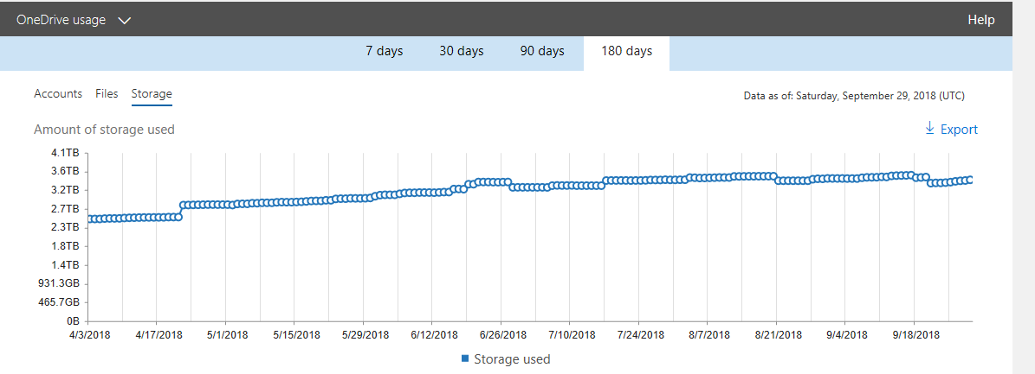
Office 365 Onedrive For Business Usage

Slide 13
Student Survey 2016 Question 15
How has having a device made your learning experience more positive - at home or school?
Answered: 843
Skipped: 71
Positive | Negative | Neutral
755 | 54 | 34
“I think that having a device has made learning easier and more connected from school to home. It's easier to access items and get teachers feed back. It also is really helpful when writing essays or papers.”
Notes:
Todd

Slide 14
OUR Technology Supports the 4 C’s
Creativity – Keyboards and Multimedia tools for expression
Critical Thinking – Beyond thinking of, thinking about – Creators not just consumers
Communication – Authentic, Expansive
Collaboration – Access to experts, Colleagues, Audience

Slide 15
todd.pickthorn@marshall.k12.mn.us
Twitter @tpickthorn
Nicholas.Esping@marshall.k12.mn.us
Kent.Powell@marshall.k12.mn.us

